Slide 1


In Partnership with

Slide 2
Building World-Class Mad Skills
Case-Solving Prep

Slide 3
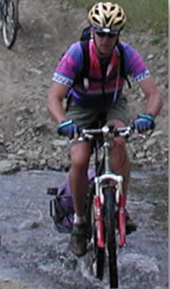
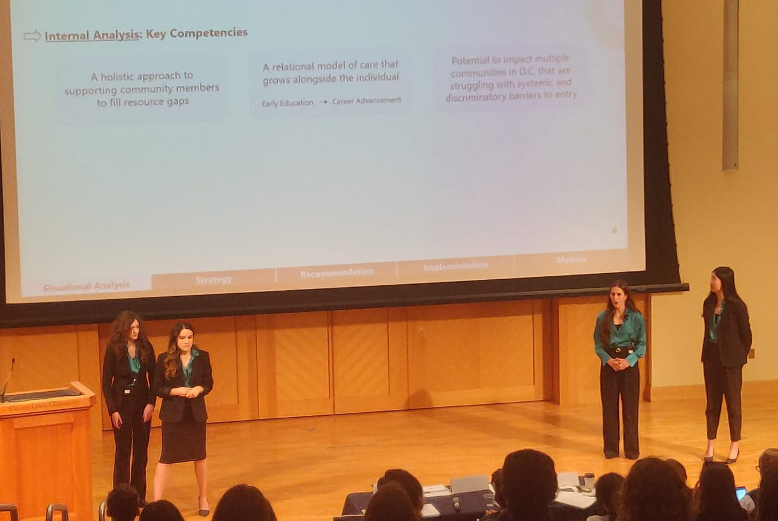
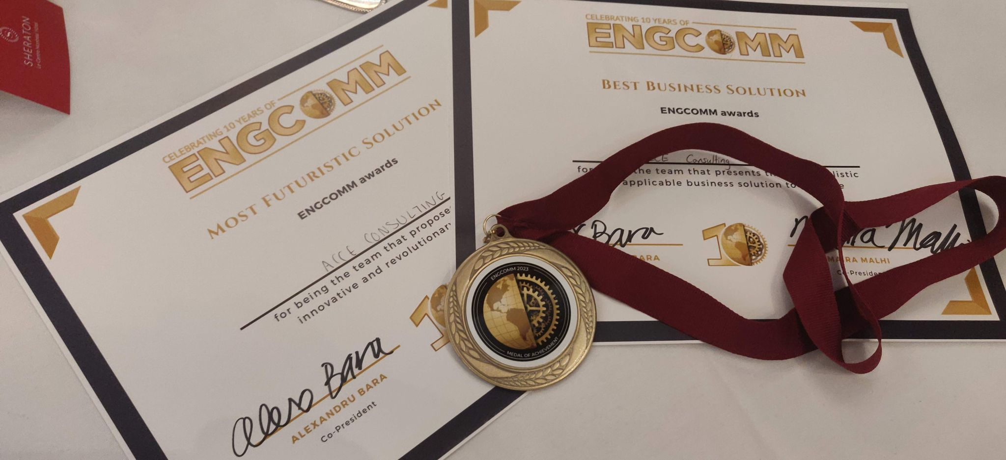
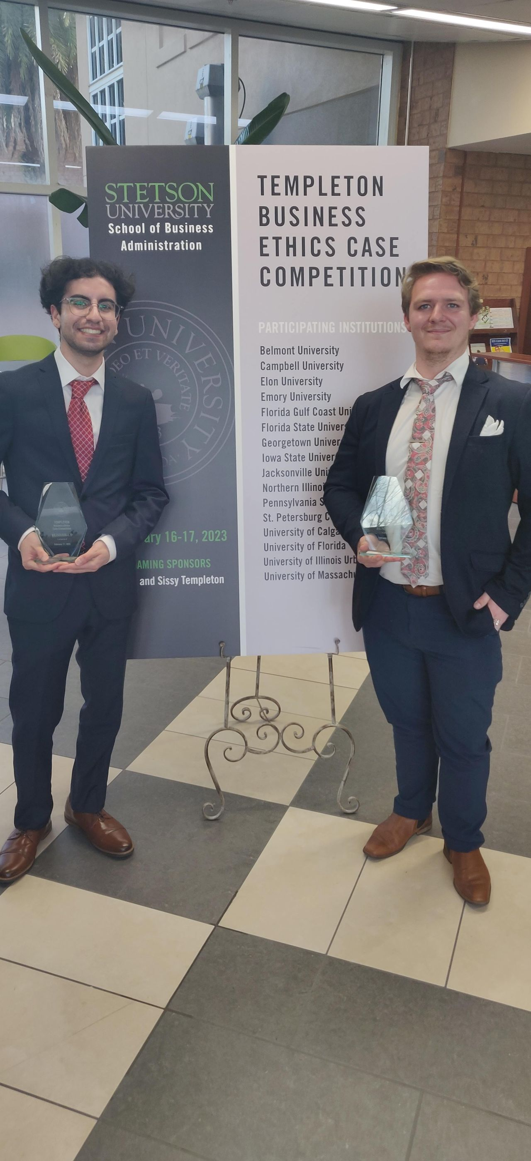

About Cam Welsh
World-class case solving mentor
Zoologist with an MBA
Family business founder
  Adventure tour company
  Sustainability consulting
Co-Founder
  Discover Your Mad Skills Toolkit
Advisory Board member
Mentor to aspiring young professionals
Associate Professor (Teaching) Emeritus
  25 years of teaching, coaching, and mentoring at the Haskayne School of Business
  Mentored 301 Haskayne/UCalgary case teams achieving 170+ awards
    Since October 2015 (185 Teams) - 112 podium, finalist, or pool runner-up finishes
    International competitions since October 2015 - 53 competitions with 21 top-three placings, 26 finals, 18 runners-up in preliminary cases, and 15 other awards
Notes:
Updated stats and photos

Slide 4



The Beginning
What is needed to set up the role-play
Engaging title
Who is the audience?
Who Position Location Date
Who you are?
Notes:
The beginning of a presentation is the title age and often it is not used effectively.
Start with an engaging title that foreshadows the solution and start the role play for you and your judges.
Tell the judges their roles (who are they based on the case information) and your role (internal or external) and take it to the ultimate in role play by adding a location and the date.
The date is dependent on the information given in the case.

Slide 5



How to Engage the Audience
Keys to engaging your audience
What are the issues?
30,000 ft recommendation
Impacts on their business
Notes:
Use an executive summary to build the context of the presentation.
What are the issues?
What is your recommendation at a high level?
What will be the impact of the recommendation? - include some impactful numbers like profitability

Slide 6
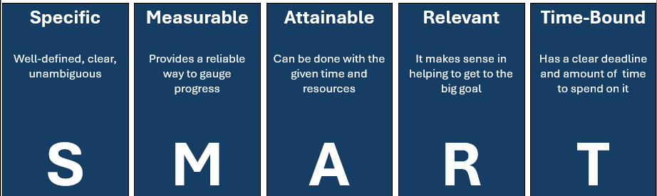
Issue Identification
SCQA
Situation
Sets the scene
Must be indisputable
Creates the buy-in
Complication
Describes the problem
The biggest tension in your storyline
Question
Asks what is going to be solved?
Must logically arise from the complication
Must be SMART
Answer
Relieves the tension
Relieves the tension
Logically answers the question

Slide 7
Building Your Solution
Your solution must be…
✓
✓
Well defended
Specific & detailed
✓
✓
Simple to understand
Realistic, feasible, & implementable
Notes:
The next step is the analysis that will defend and support your solution.
The analysis needs to be
Specific and detailed
Simple to understand (the recommendation also must meet this requirement)
Lead to a recommendation that is realistic, feasible, and implementable

Slide 8




Components
What you must deliver to the audience
Shows
Insights from the internal and external analysis
Easily understood decision including the criteria used
Answer these Questions
How does the organisation make it happen?
How does the organisation know it happened?
Notes:
The keys to communicating a good business case include
insights from your analysis
an understandable decision based on well-defined decision criteria
An understanding of how the company can make the recommendation happen
an understanding of how the company knows it is working

Slide 9



Beyond Just an Answer
Creating a winning solution
Risk
Mitigation
Strategy
Risks = Analysis
Mitigations = Implementation
You asked we answered
Answer your clients' questions
The future and beyond
Notes:
Some of the extras that add to your solution (not really extras) include
Risk and mitigation strategy as this will help you deal with the most important questions will have – those focused on minimizing the risks built into the solution
Often there are questions in the case – make sure you answer them and make sure you let the judges know you answered them.
Talk about the future (after the solution) as most often you role-play external consultants, and they are always looking for their next jobs (future considerations)

Slide 10



Closing the Sale
You must close the sale to be successful
Exude Confidence
Think Impacts
Talk Value Proposition
Deliver value
Close with high energy
Notes:
Most students hate hearing this, but you are a salesperson when you presenting, and your job is to sell your ideas.
As you end your presentation it is your job to close the sale by conveying the value your solution delivers and do this with high energy – it is exciting to close the sale and high energy conveys confidence.
I personally hate it when teams end with now we open the floor for questions as you know they are coming.
End on a mic drop moment – you will be different than all the other teams.

Slide 11






Winning Solutions
Winning solutions incorporate these elements
Checks off the
scorecard
Quantitative & qualitative
support
Comfortable with
the Issues
Likable
Confident
Consistent
Notes:
Over the years this slide outlines what I have seen that winning team have in common.

Slide 12
Judges are Seeking Clarity
How do you help the judges get more clarity?
Rule #1: Answer the Question Asked
1
Listen to the question
Seek clarity if needed
Rule #2: Never Contradict the Presentation
2
If you do, you might as well leave when this happens
Rule #3: Never Add on to your Teammates Answer
3
Shows a lack of trust
If the judge does not get the expected answer, they will ask in another way
If you don’t know the answer – don’t be afraid to ask the judges to repeat the question
Usually adds little value
Does not allow the judges to get through their questions
Notes:
Review the points on the slide.
Rule 1 is violated over and over in competition and often is a difference in team’s success.
In over 10.000 presentations in my coaching career, I can count on a couple of hands the times adding on has added more value that an additional question or the question being asked in a different way.

Slide 13
Be Authentic
Always do you
Do “YOU”
Let your personality come through
Smile
Be warm
Use your hands
Be open
Be supportive
Position on the screen
Notes:
DO YOU!
Let your personality come through and have some fun with it – it makes you more likable and people will listen in a more engaged fashion with you.
Think about the presentations you have enjoyed the most – what have those speakers done.

