Slide 1



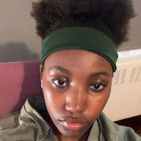
The Youth and Personal Finances: A Love/Hate Relationship
By Maxime Giroux, Rozhin Mohamadi, Francesco Arcuri & Helen Charles

Slide 2
Introduction
The Youth and Personal Finances: A Love/Hate Relationship" looks at the mixed feelings young people have about money.
They enjoy the thrill of financial independence and the ability to budget and save for their futures.
However, challenges like student debt and rising living costs can turn excitement into stress.
This creates a complex dynamic where they must balance their dreams with the realities of managing their finances effectively.

Slide 3
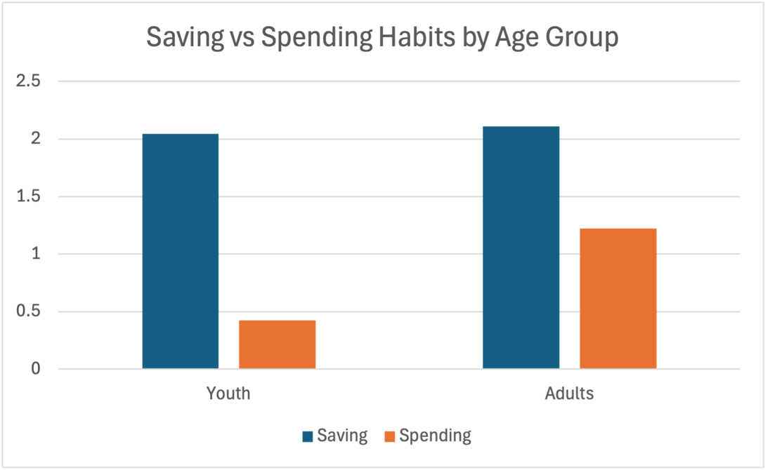
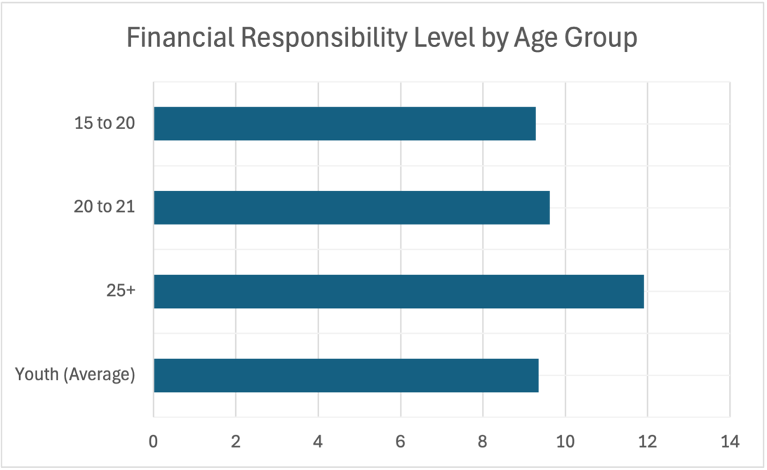
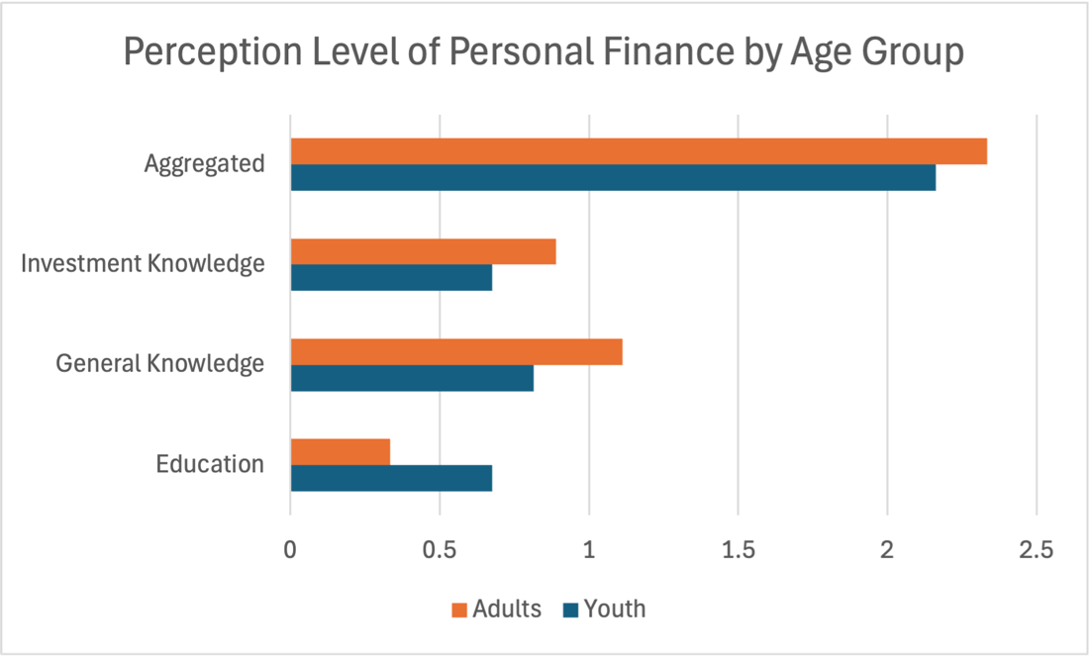
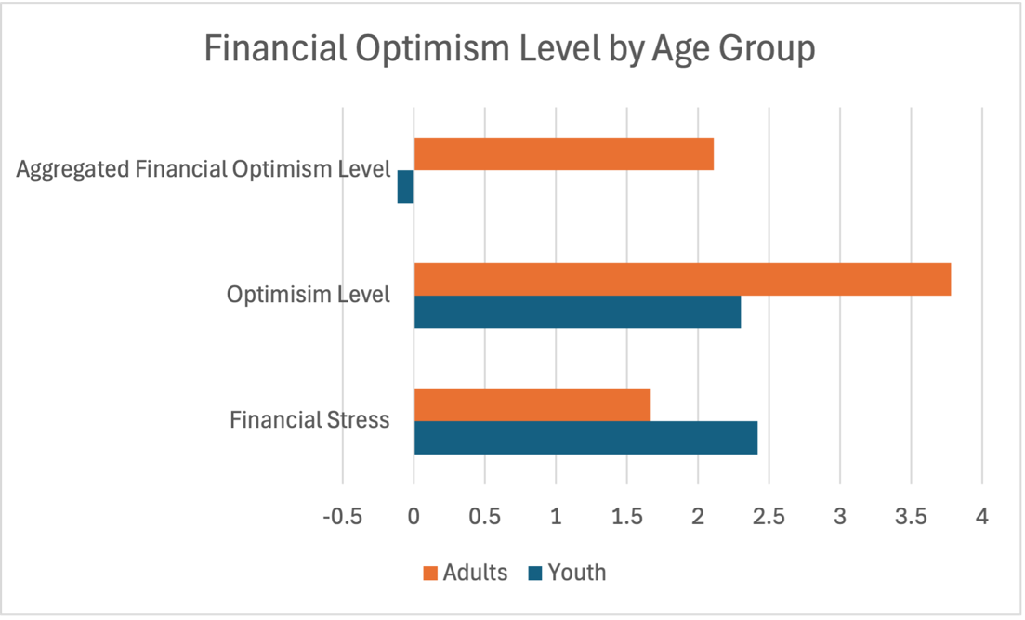
Thesis:
Is the youth financially responsible and what do they think about their financial future?
The youth showcases a constant state of financial stress.

Slide 4
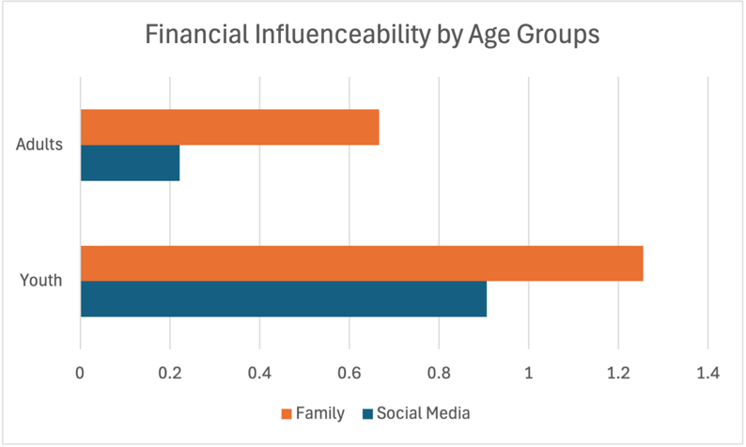
Thesis: Continued
The youth displays very high level of influenceability from any source.

Slide 5
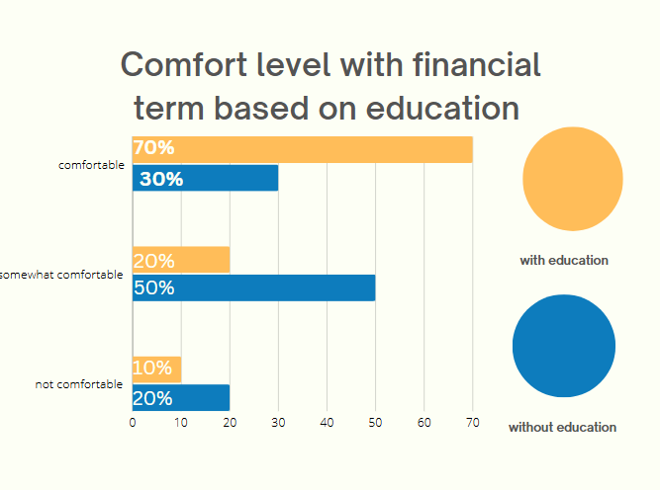
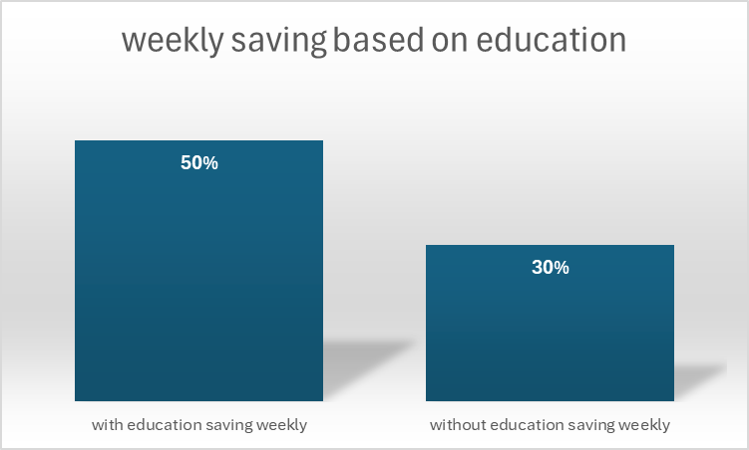
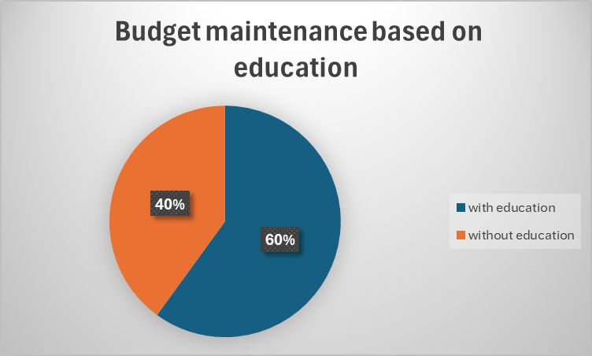
Hypothesis 1:
Young adults who receive formal education in personal finance are more likely to demonstrate financial responsibility and exhibit positive saving habits compared to those without such education.

Slide 6
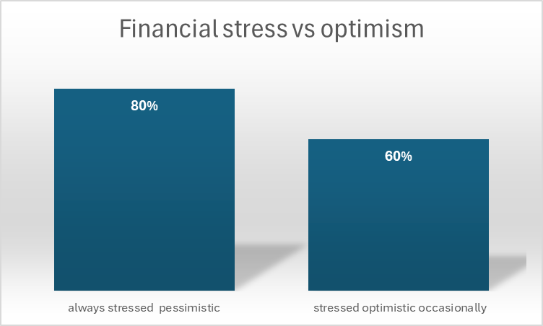
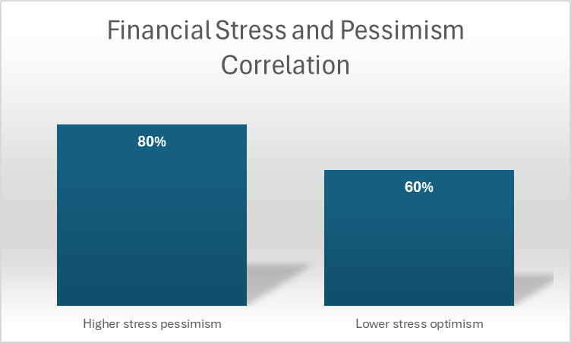
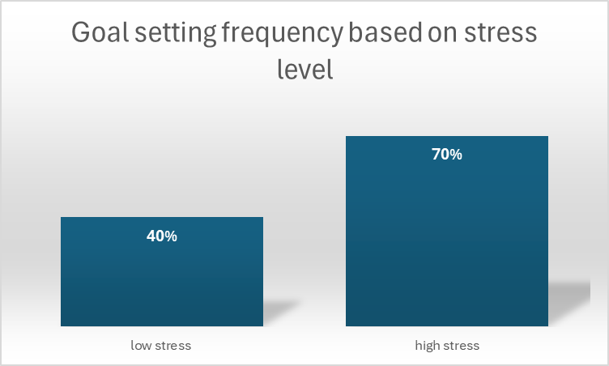
Hypothesis 2:
The level of financial stress experienced by youth is negatively correlated with their perception of financial responsibility and optimism about their financial future.

Slide 7
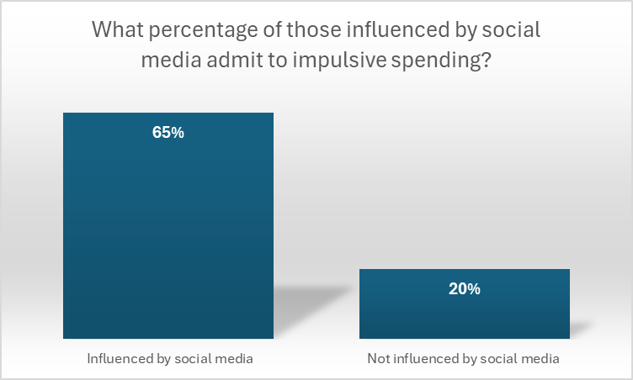
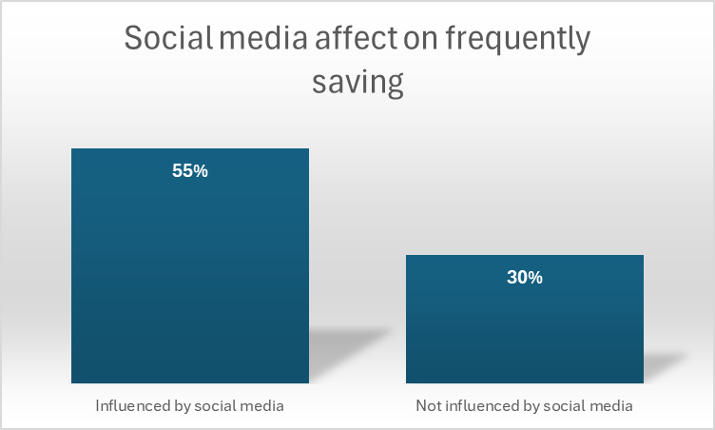
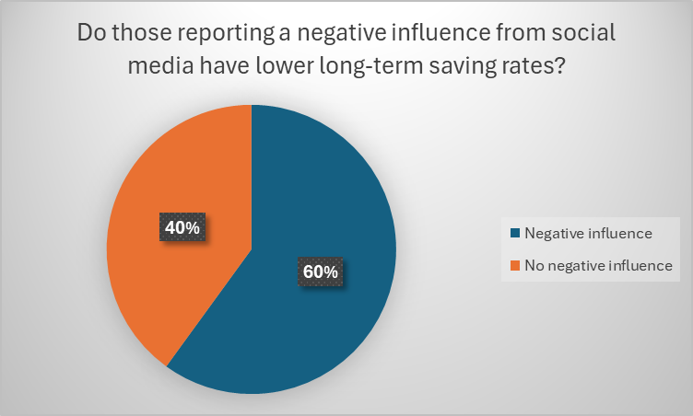
Hypothesis 3:
Social media influences youth's financial decision-making, leading to a greater tendency to engage in impulsive spending rather than saving for long-term financial goals.

Slide 8
Research Methodology
Questionnaire Structure:
- Demographics (age, education level, socioeconomic background)
- Financial Literacy (knowledge of financial concepts such as budgeting, saving, credit, and debt)
- Financial Behaviors (saving habits, spending patterns, and money management strategies)
- Attitudes and Beliefs (perceptions of financial responsibility, attitude toward debt, short-term vs. long-term financial goals)
- Influences (sources of financial information: family, friends, school, social media)
Focus Group:
- Introduction: Explain the purpose of the discussion and ensure confidentiality.
- Icebreaker: Discuss participants’ first experiences handling money independently.
- Topics:
  Financial Goals: What are their short-term and long-term financial goals?
  Financial Literacy: Where do they turn to for financial advice or information?
  Challenges: What are the biggest challenges they face in managing money?
  Influences: How do peers, family, social media, and schools influence their financial habits?

Slide 9

Questionnaire: Ethics Form
The study aims to explore the financial literacy levels among young people, focusing on their understanding of essential financial concepts such as budgeting, saving, debt management, and investing. By investigating the current state of financial knowledge and skills, the study seeks to identify gaps in financial education and potential factors that influence financial literacy, such as socioeconomic background, educational exposure, and access to resources. Insights from this research will contribute to the development of targeted educational programs and resources that can empower youth to make informed financial decisions and foster long-term financial well-being.
Study Procedures:
If they agree to participate, participants in this study will be asked to complete a structured questionnaire, which includes questions related to their knowledge, attitudes, and behaviours concerning financial literacy topics such as budgeting, saving, credit, and investments.
Confidentiality:
All information provided by participants will be treated with strict confidentiality. Personal identifiers are not collected and all data will be stored securely, following ethical guidelines and regulatory requirements, and will be used solely for the purposes of this study. In any published reports, individual responses will remain anonymous to ensure that no participant can be identified.
Voluntary Participation:
Participation in this study is entirely voluntary. Participants have the right to refuse to participate or to withdraw from the study at any point, without any penalty. Should participants choose to withdraw, their data will be excluded from the analysis upon request.
Potential Risks:
The risks associated with participating in this study are minimal. However, participants may experience mild discomfort when reflecting on their financial knowledge and habits, especially if they feel uncertain about their financial literacy.
Benefits:
Participants may gain personal insights into their financial knowledge and practices, which could lead to increased awareness and motivation to improve their financial skills.
Consent Statement:
By choosing "I agree" in this consent form, you confirm that you have been informed about the purpose, procedures, potential risks, and benefits of the study. You acknowledge that your participation is voluntary, that you may withdraw at any time without penalty, and that your confidentiality will be maintained. Your signature indicates your consent to participate in this research, with the understanding that your data will be handled securely and anonymously.
In the event where a participant does not agree with the conditions, they are invited to exit the form.

Slide 10
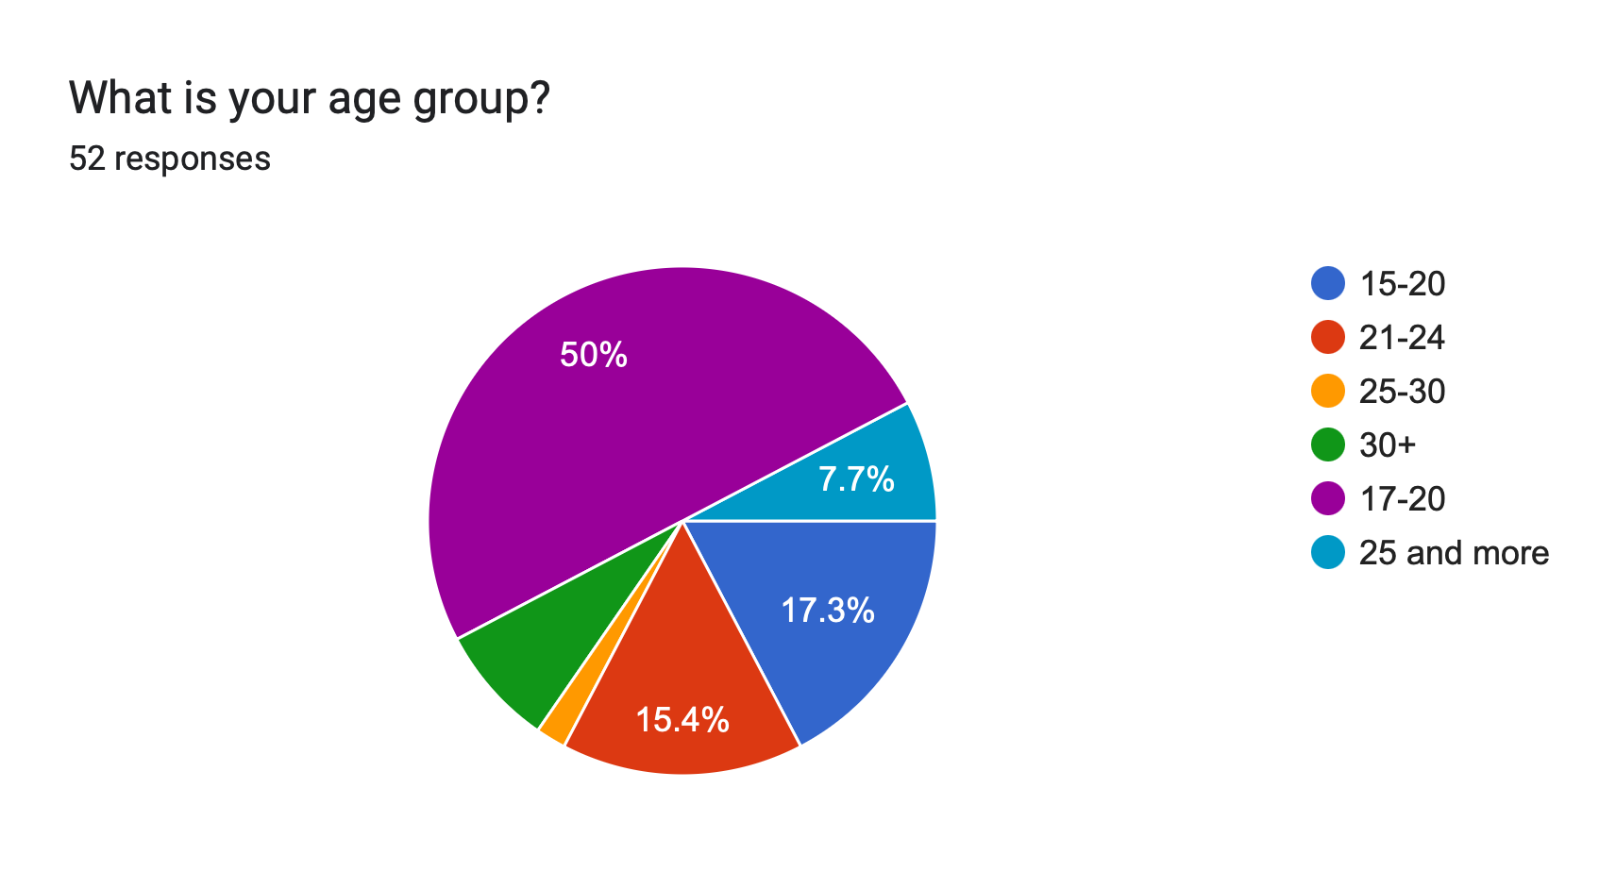
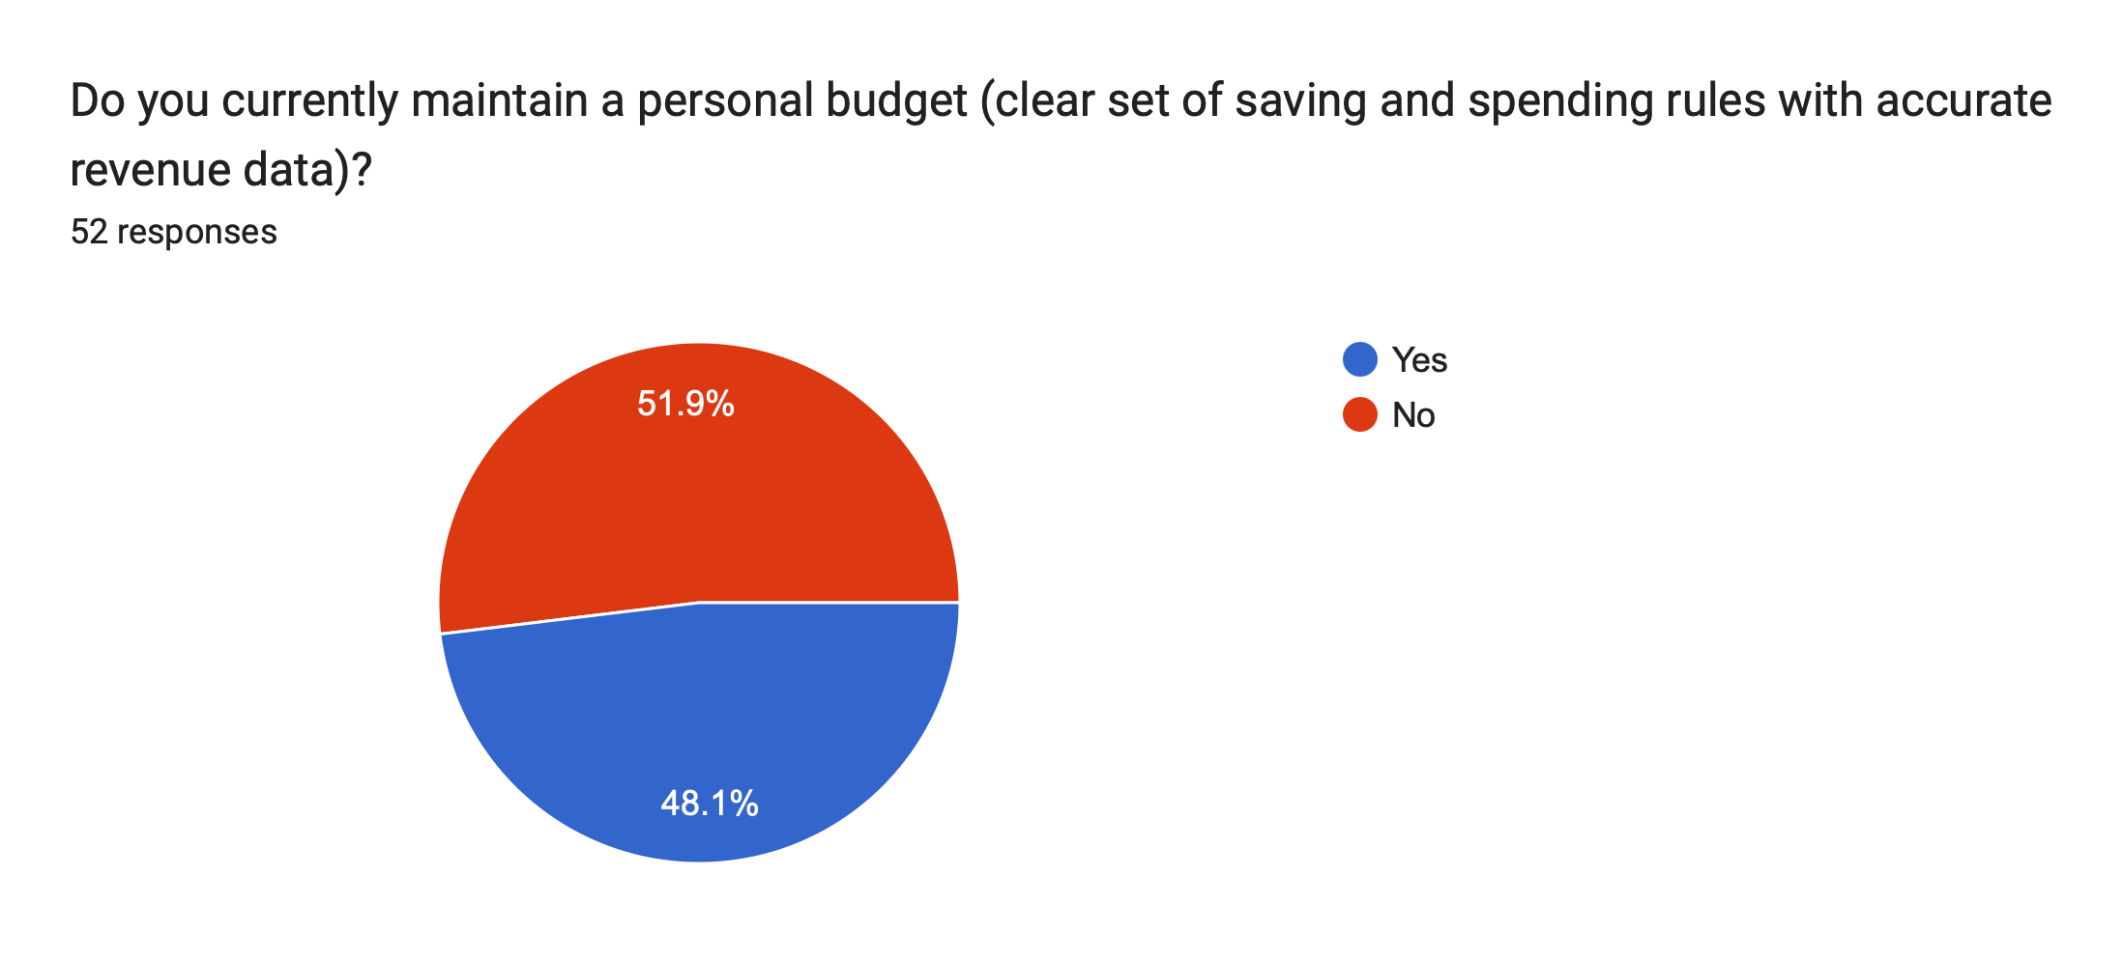
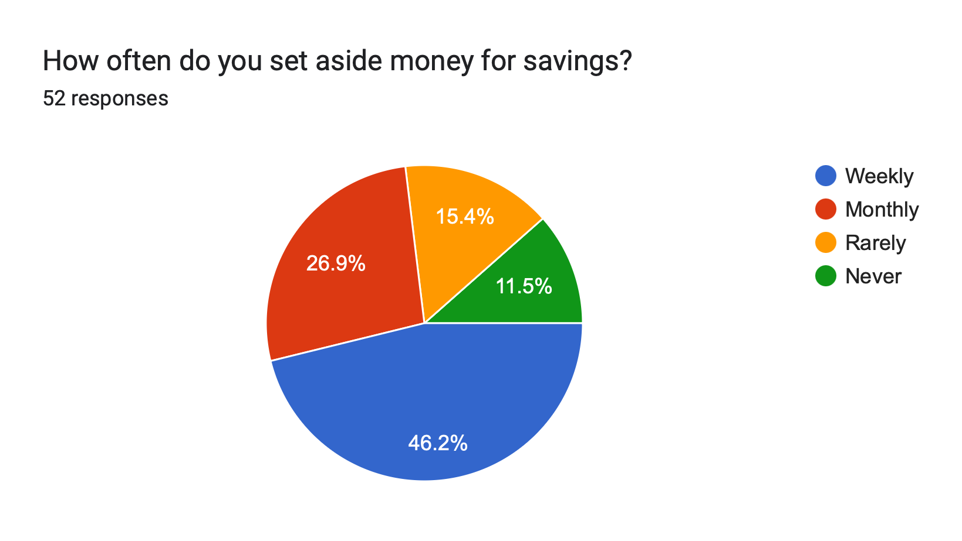
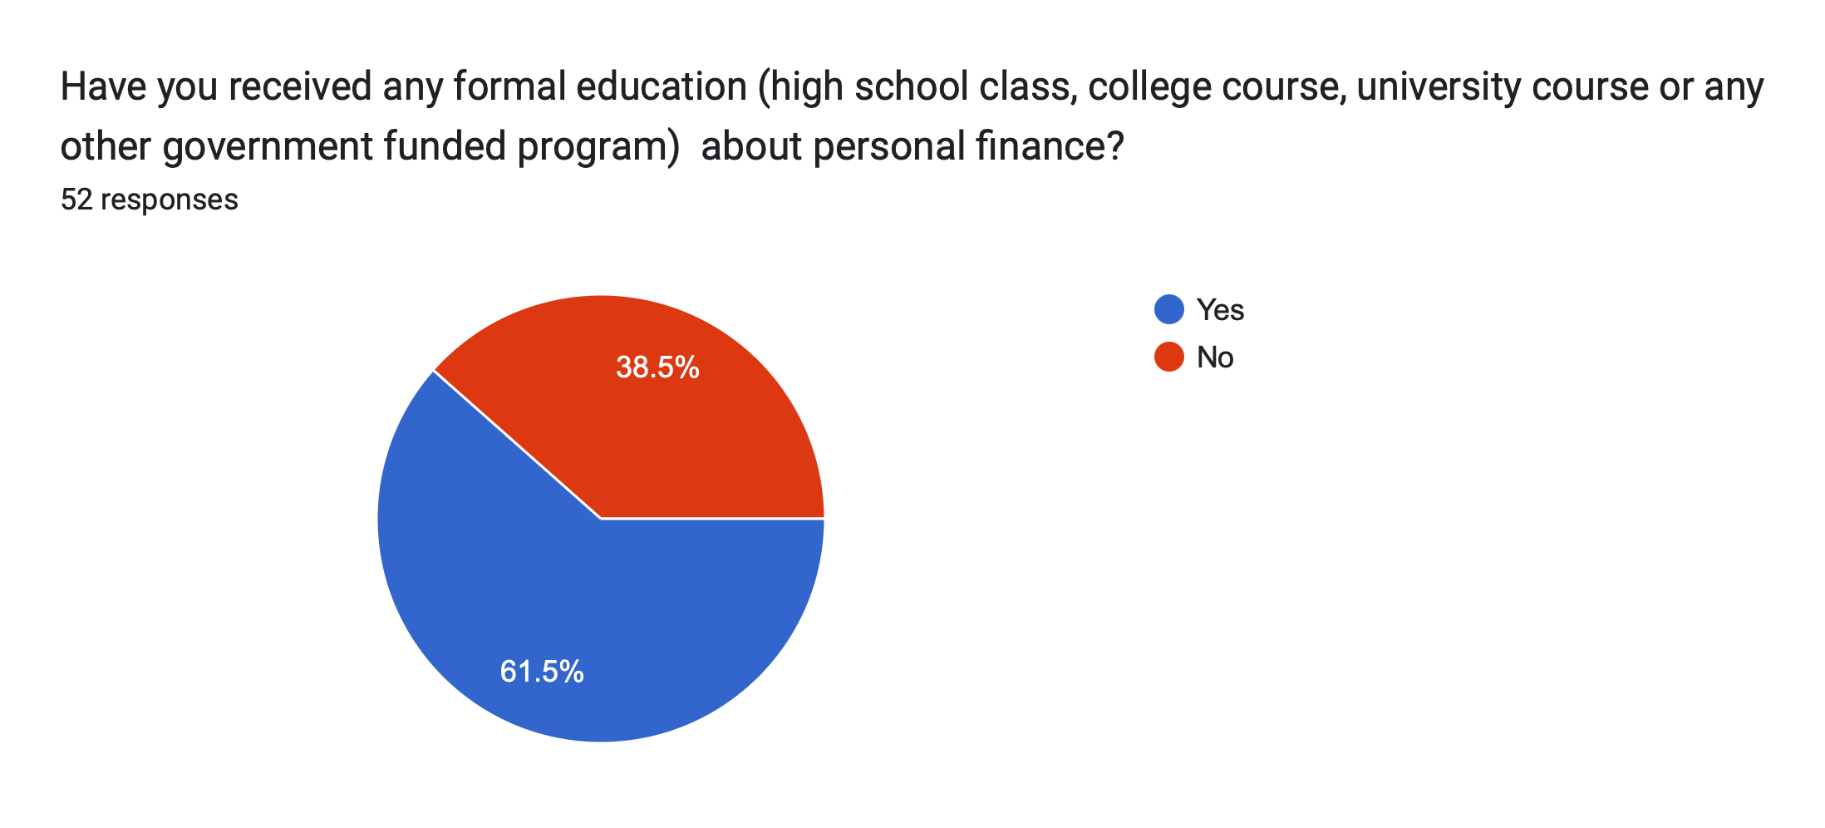

Slide 11
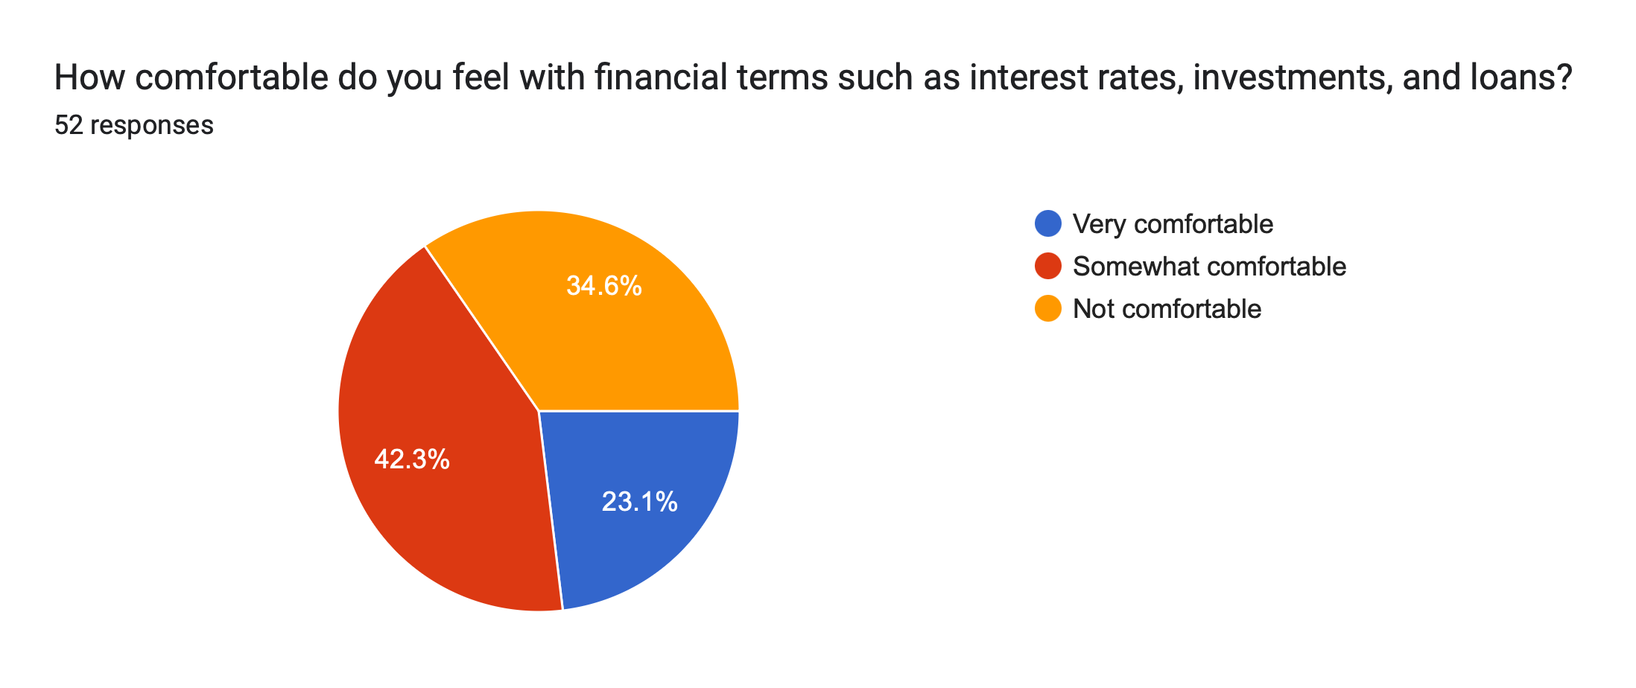
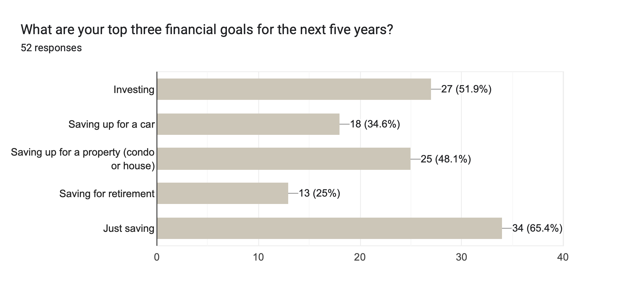
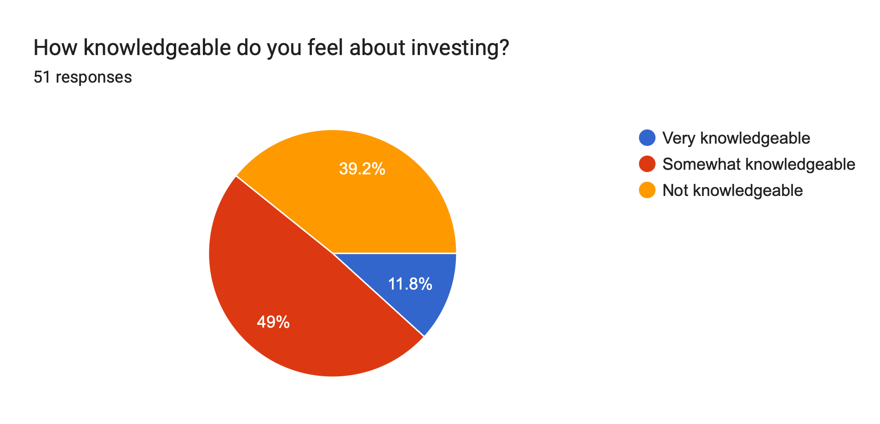
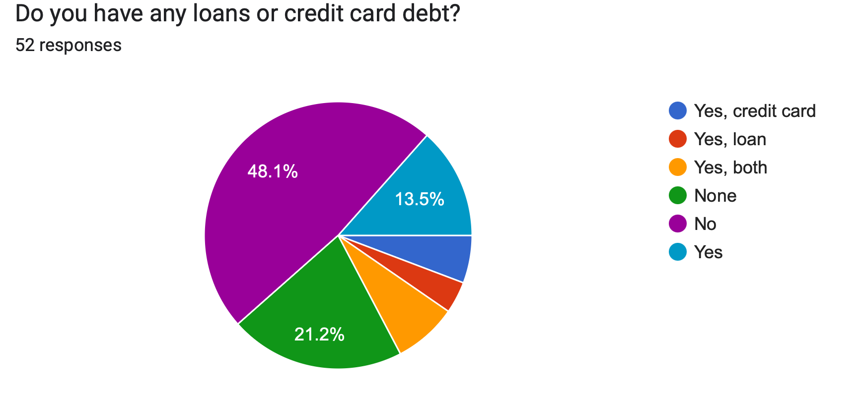

Slide 12
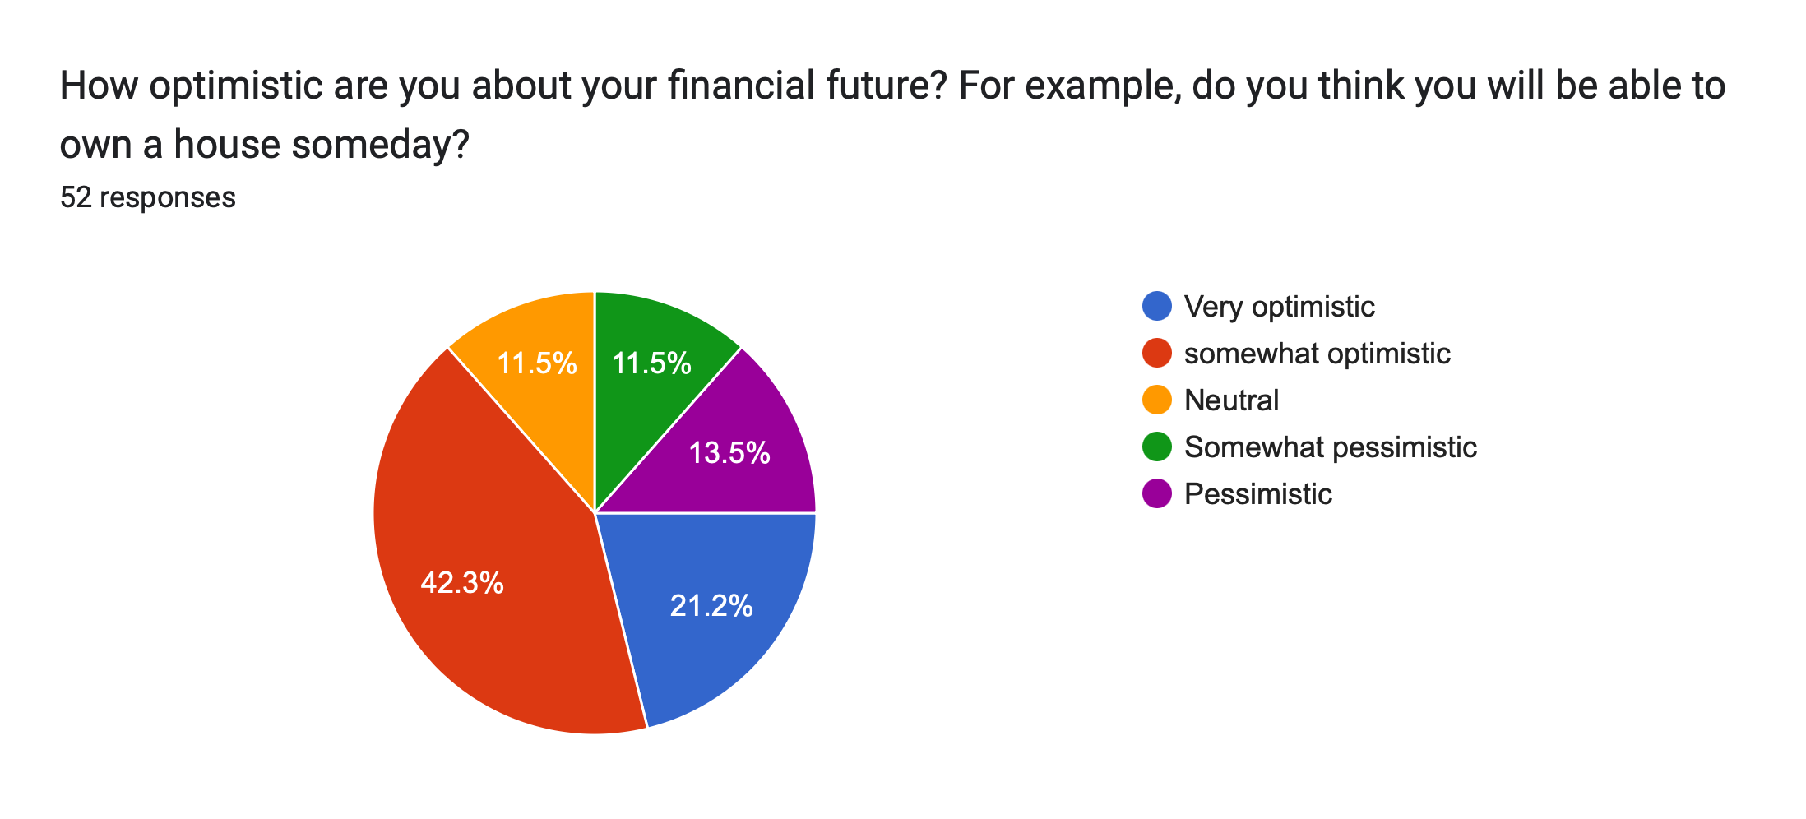
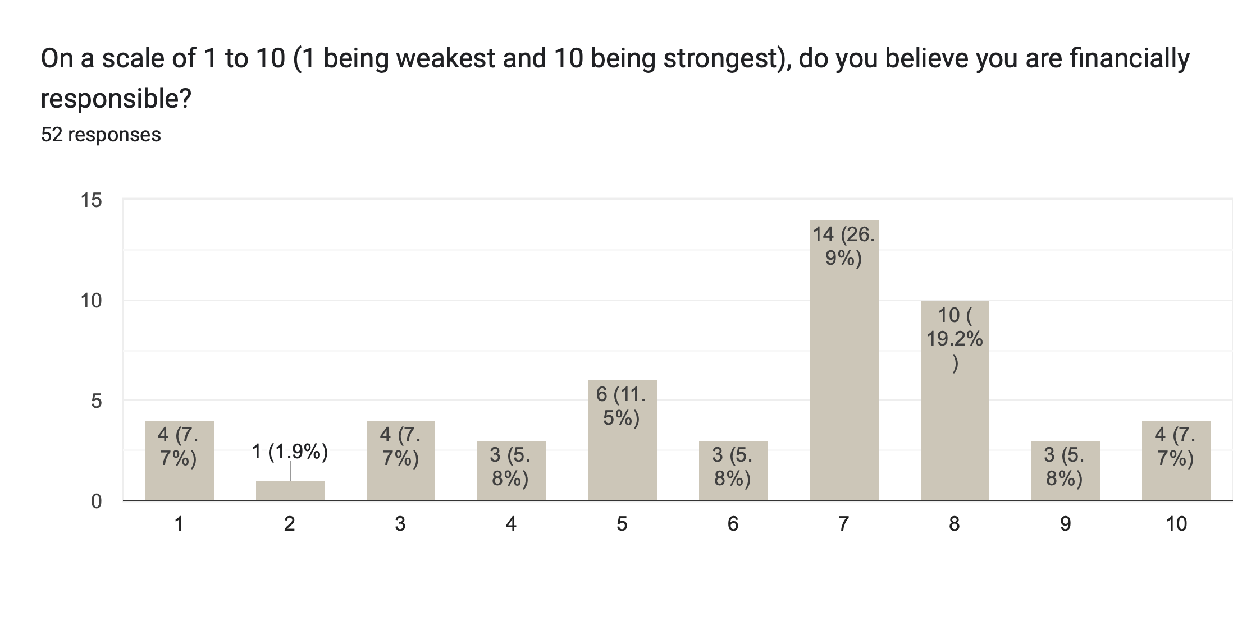
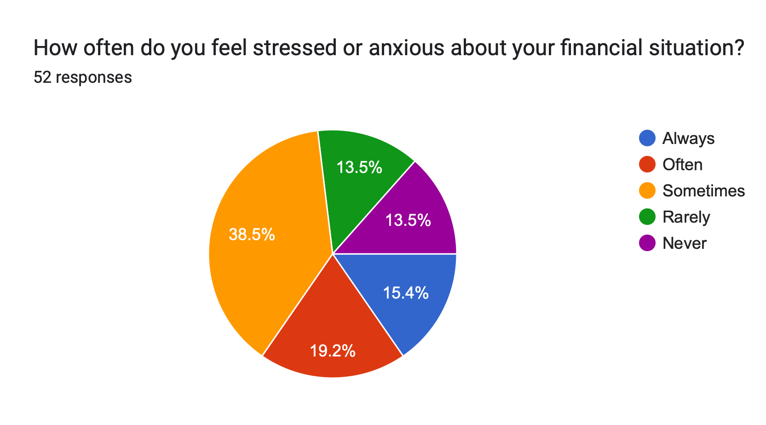
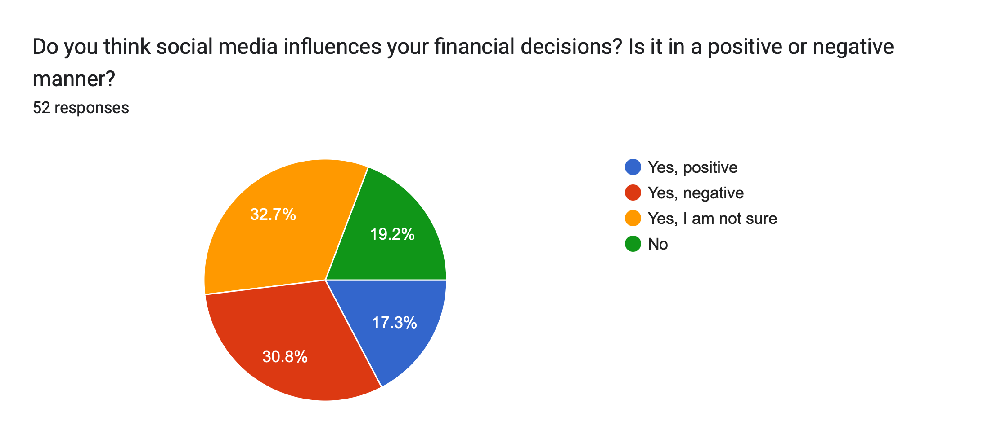

Slide 13
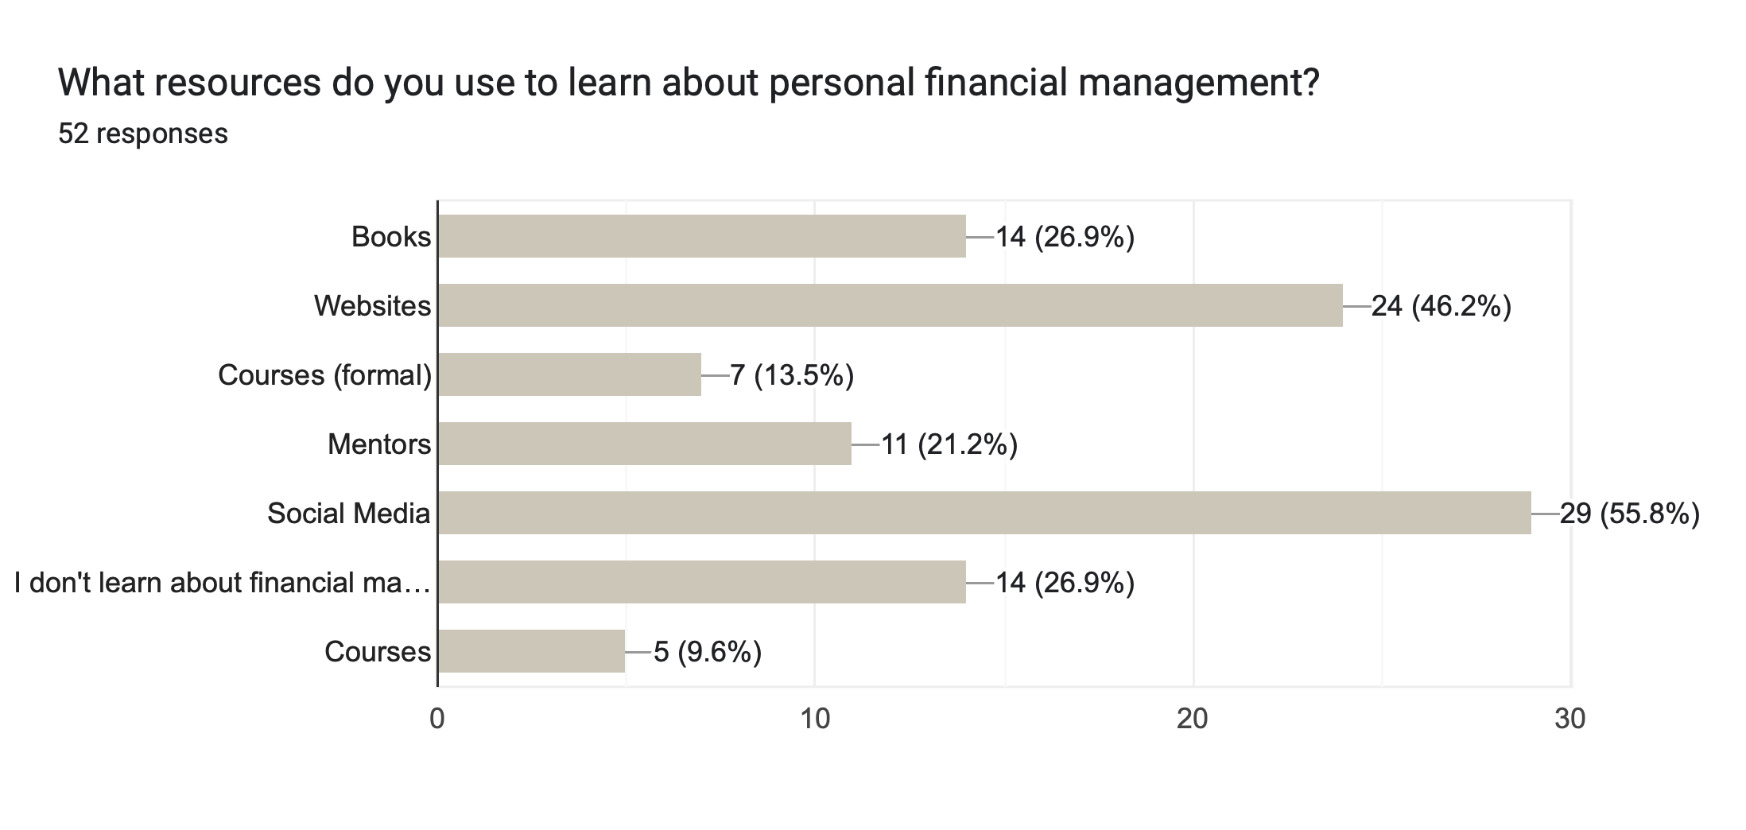
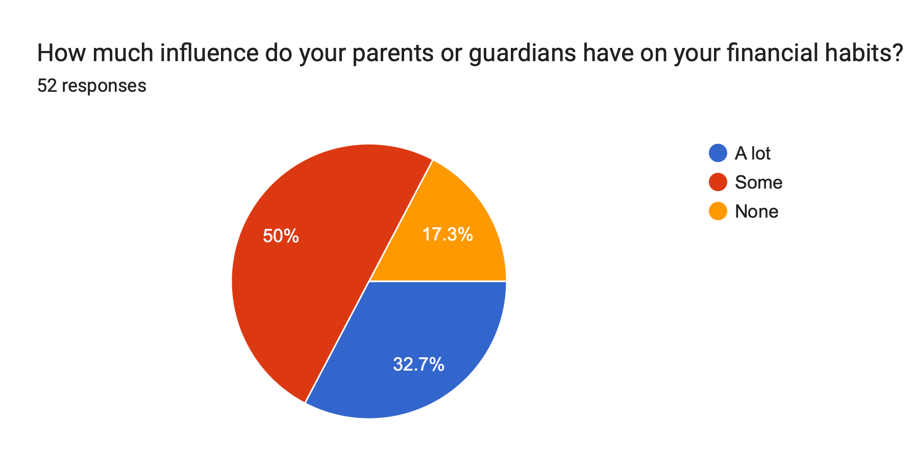

Slide 14
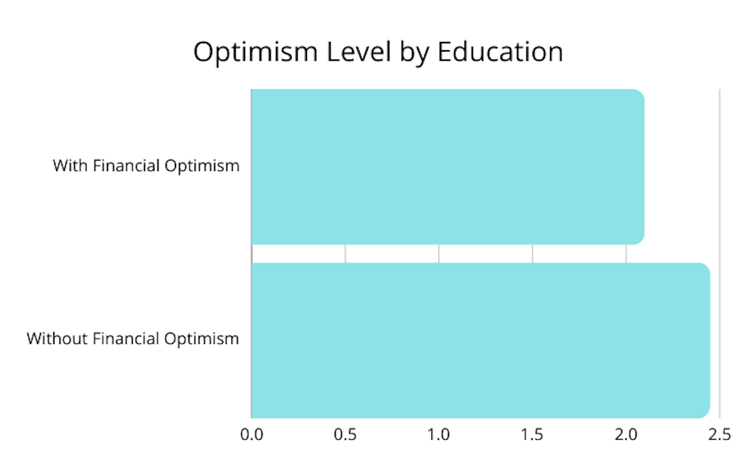
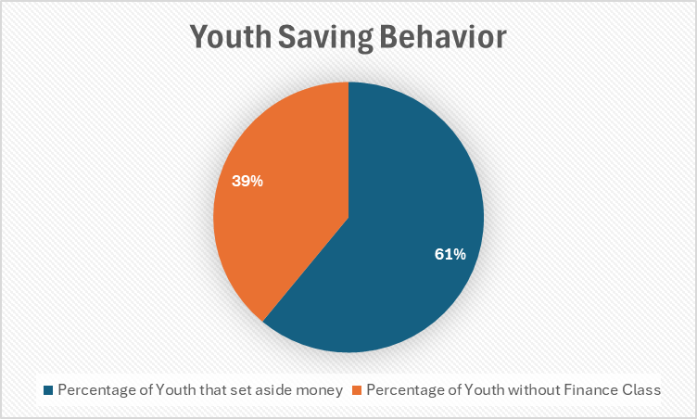
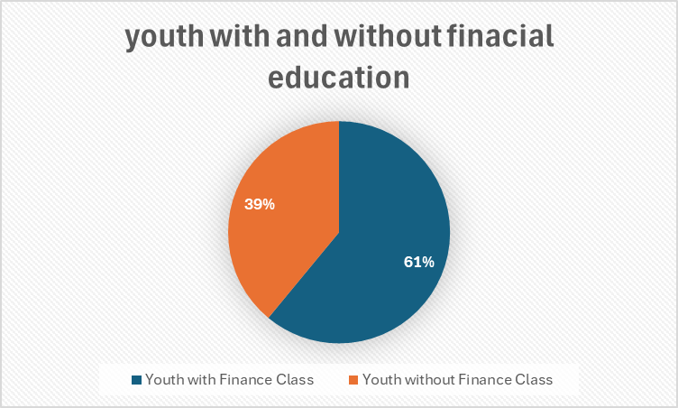
Questionnaire: Data Assessment

Slide 15
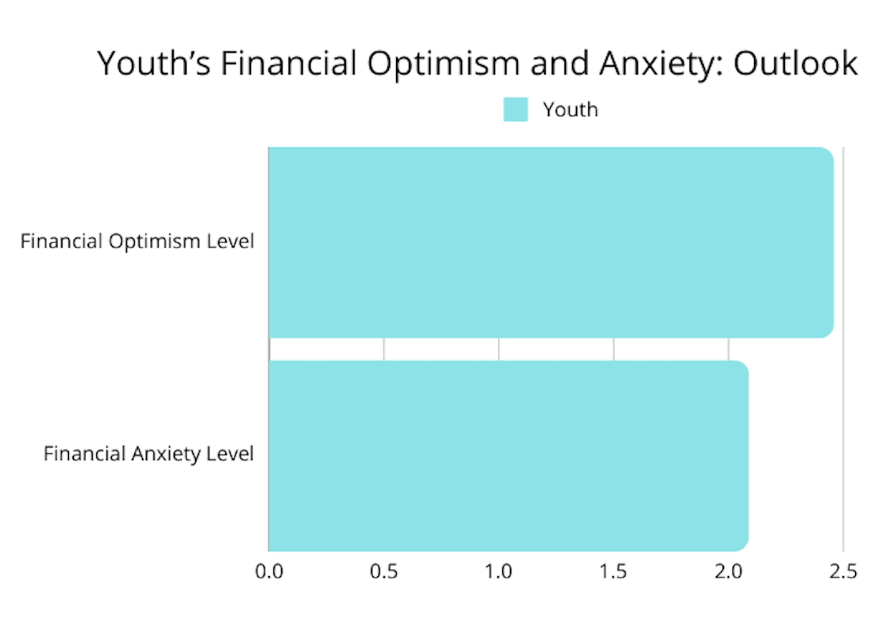
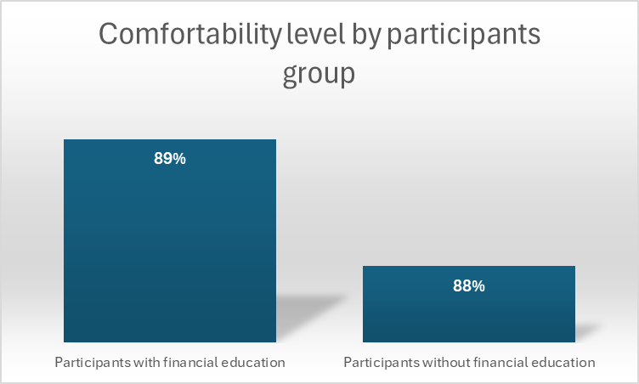
Questionnaire: Data Assessment Questionnaire: Data Assessment

Slide 16
What does it mean?
These responses indicate that while young people have a general awareness of financial principles, there are notable gaps in planning habits, confidence, and access to resources.
Participants with some education in finance demonstrate higher responsibility and comfort with finance.
Although most participants do not follow a budget (53%), most of them rate themselves as moderately to highly financially responsible (7 as the average).
This indicates a bipolarity in the youth’s way of thinking.
Being financially responsible might have another meaning for them

Slide 17

Focus Group: Initial Plan
Selected 6 participants: all different levels of education
Voluntarily participated in the focus group
Sessions were 1 on 1 (individual) and lasted 20 to 30 minutes
Goal was to assess personal accountability on personal finance and beliefs on future economy, as well as possible influencers on one’s decisions.

Slide 18
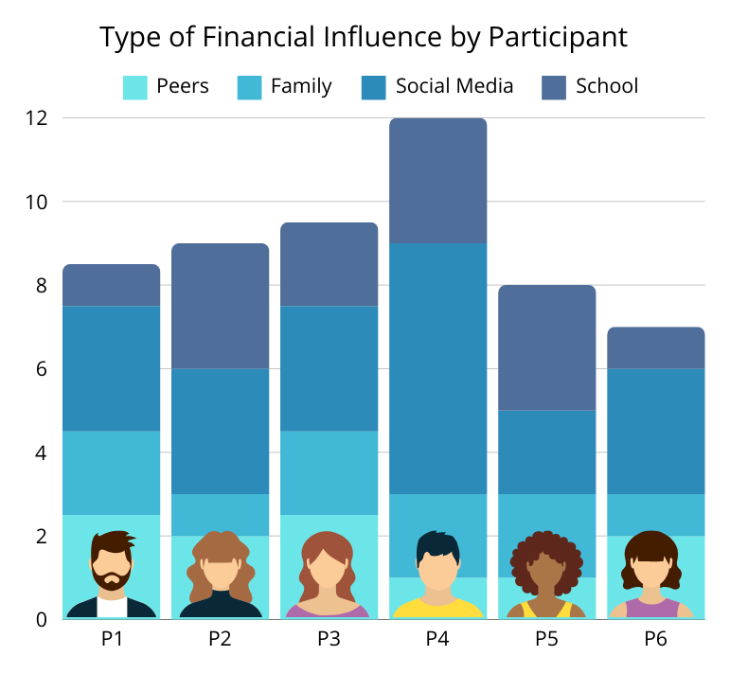
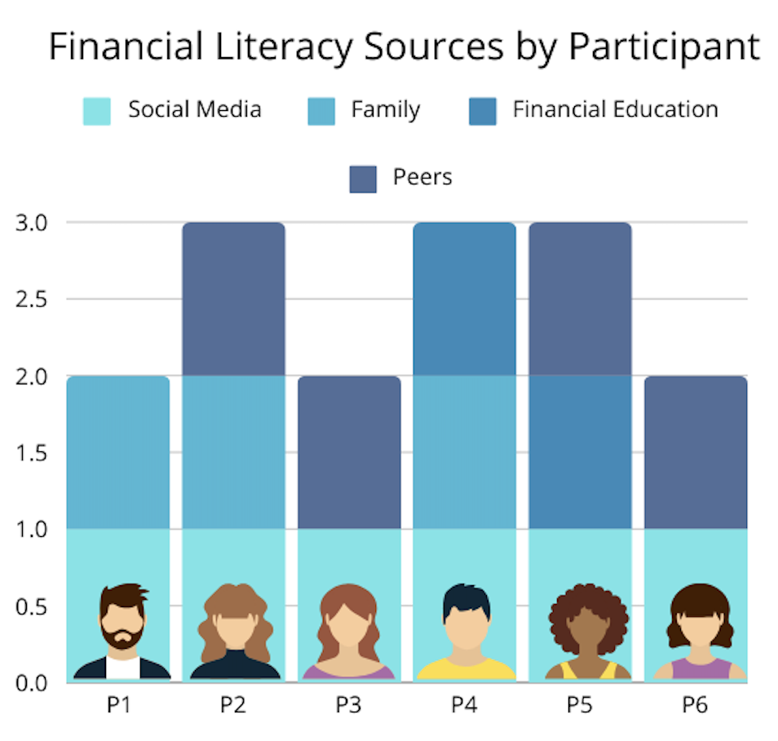
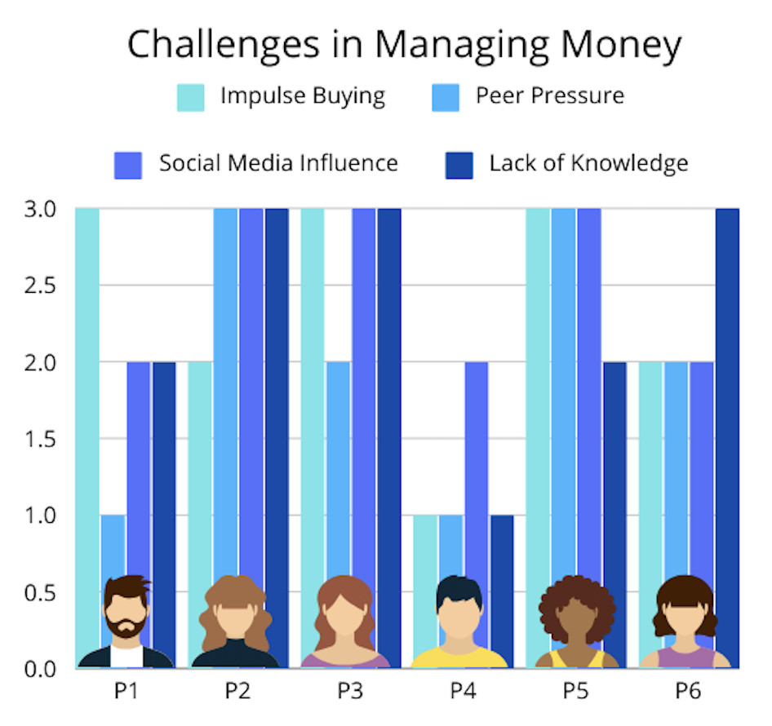
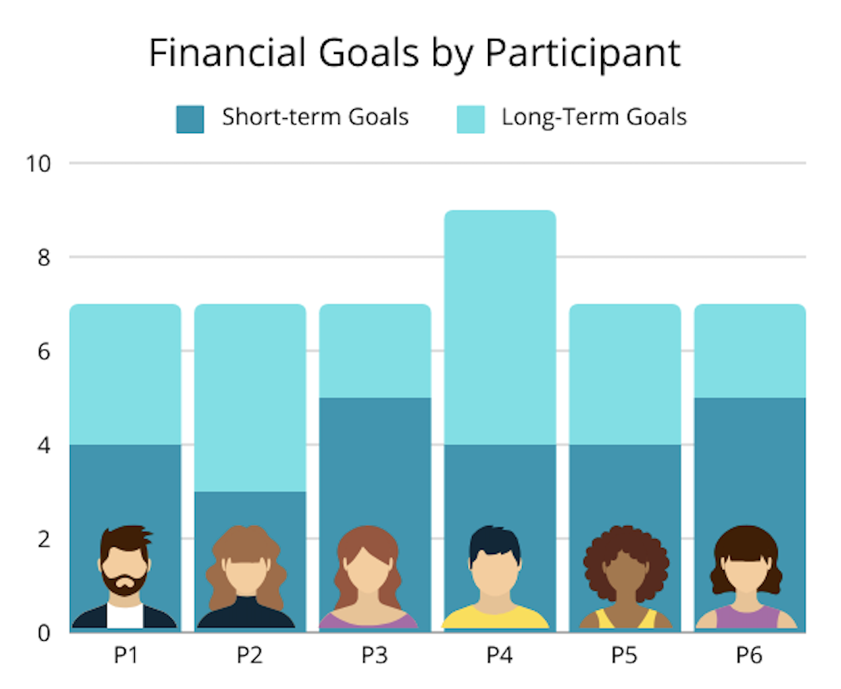
Focus Group: Visualized

Slide 19
Conclusion
With all our data, we found that the difference between none and some education creates a BIG difference in financial responsibility.
Implementing financial literacy classes in high schools as part of the regular curriculum can play a transformative role in equipping the younger generation with essential skills to fight financial insecurity.
Studies show that individuals with some financial education are more likely to save and make smart financial decisions because it encourages disciplined budgeting and builds an understanding of the benefits of investing.

